Slide 1

DriverPass System Analysis
Ryan Erno
Notes:
[No speaker notes required for this slide.]

Slide 2

System Requirements
The system shall allow automatic password resets for users
Needs to be accessible from any browser(Chrome, Safari, Firefox, etc.)
The system needs to be Web-based and run off a cloud service.
Should be relatively fast, capable of keeping vast amounts of data updated in real-time.
Notes:
For my non-functional requirements I chose to include the need for the system to be fast and the need for it to be web-based. This is important because the system needs to be able to handle many concurrent users at a single time and be able to maintain an up-to-date database on DMV polices and user information as well as appointment info. The system also needs to be web based as the staff do not want to be bothered with having to maintain its security and updates, instead a web and cloud-based system covers that. For my functional requirements I went with the need for password resets and its ability to be accessed from any browser. This is important because the system is intended to serve various amounts of users, by incorporating compatibility it ensures that any user with any preferred taste is not limited. The automatic password reset ensures that users despite forgetting their credentials can still access the system so long as they make a new password, continuing to ensure proper security measures.

Slide 3
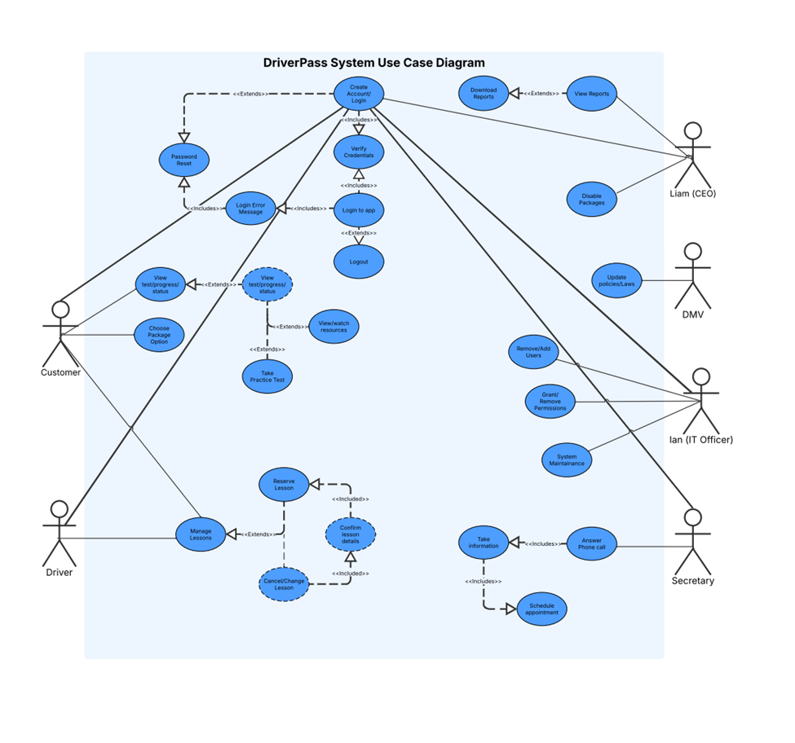
Use Case Diagram
[Insert your use case diagram here.]
Notes:
In my diagram the people who interact with the system include Customer, Driver, CEO, DMV, IT Officer, and Secretary. As for the different things that these people will be able to do, I will keep it very simple as my diagram is rather complex, For customers they will need to be able to view and choose different package types, take tests, and be able to view different sources as well as their progress and their drivers. The drivers themselves need to be able to manage the lessons, including the ability to change or cancel them as well as confirm and reserve them. The CEO needs to be able to have complete control over the package options including the ability to disable them, he also needs to be able to view and download reports at any time including offline. The DMV simply acts to provide updates as they change their polices and laws. The IT Officer needs to perform security maintenance and has the full ability to change or remove users accounts as needed and can also perform manual password resets if required. The secretary needs to be able to take phone calls and take in customer information as well as having the ability to schedule appointments on behalf of the customer. Finally, we have the login process which entails a user either creating or logging into an existing account. If their username and password match, they are allowed into the system otherwise they are denied and may have to reset their password. It is important to note that every person is connected to an account and must perform the login process.

Slide 4
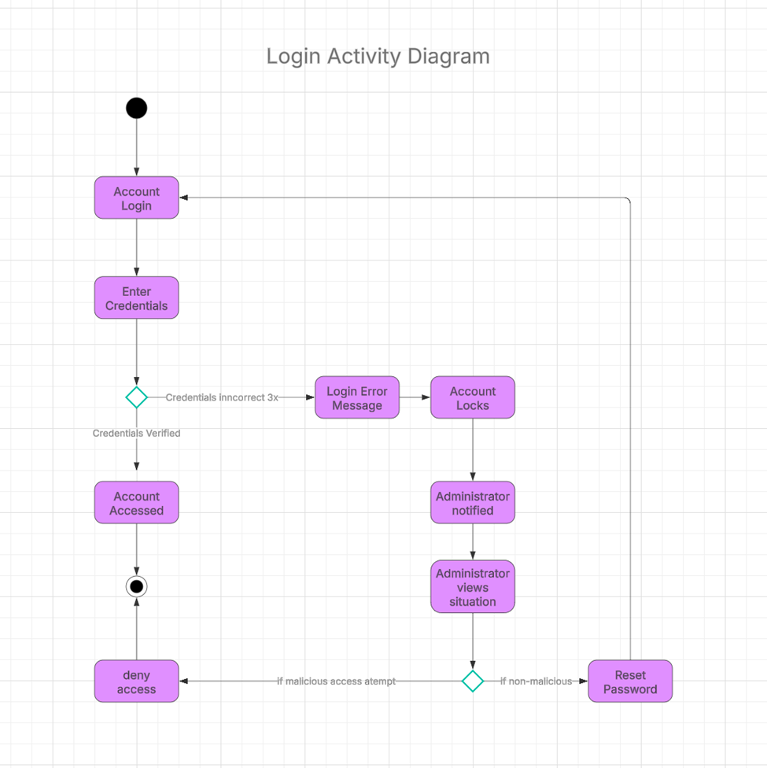
Activity Diagram
[Insert one of your activity diagrams here.]
Notes:
For this Activity diagram I am breaking down the login process, the DriverPass system needs security measures to protect its users and resources to do this, it needs to have users enter their usernames and passwords and check it against what is stored in the system. Users will be able to make up to 3 attempts to account for mistakes but after that the account will be locked to protect it from here, the IT officer will be notified of the incident and can decide on whether it was accidental or was intentional. Depending on which one the Officer can either further protect the system by denying access or manually resetting the password instead. Otherwise, if the users' credentials are correct, they will be allowed to access the system.

Slide 5
Security
Proper username and password are needed to access the DriverPass System.
Ensures that only authorized user can use the system
Limited attempts protects against brute force methods.
Notes:
I considered security in my design by ensuring that a user must provide a valid username and password to access the system, this helps to make sure that only proper authorized user can use the DriverPass system. By also incorporating a limited number of attempts on password and username inputs I help to protect the system from hackers trying to force their way in by essentially throwing several different combinations of inputs.

Slide 6
System Limitations
Changes to the system(Rules/Policy) are solely determined by the DMV.
Limited development lifecycle.
Web browsers changes and updates
Limited customer package options.
Notes:
The DMV will actively be providing updates based upon their changes to policies and laws which could affect the design and layout of the system, these changes could be unpredictable and cause a need to overhaul the current design several times over in the future, this is also true for the web browser changes. If the associated companies that oversee the browsers end up making changes it could both affect the future compatibility and current method of accessing the system. The system design only have a limited schedule for design, which affects both the quality and final layout of final product. A longer development cycle could allow for additional features and stability as well as more robust security. Lastly, the design only accounted for a limited number of package options for the customers, it was heavily implied that changes would be made to this feature, an additional number of packages or changes could affect the operation of the system.

